Slide 1
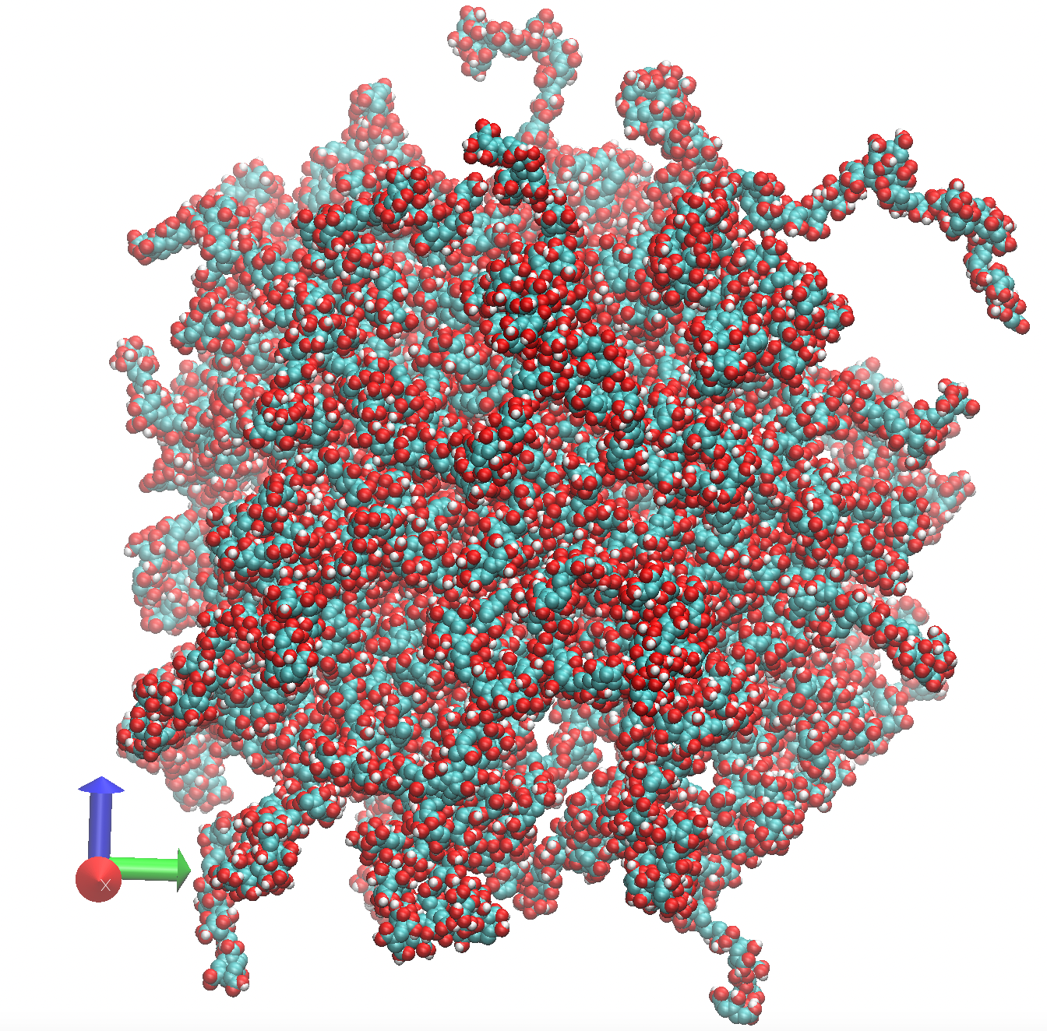
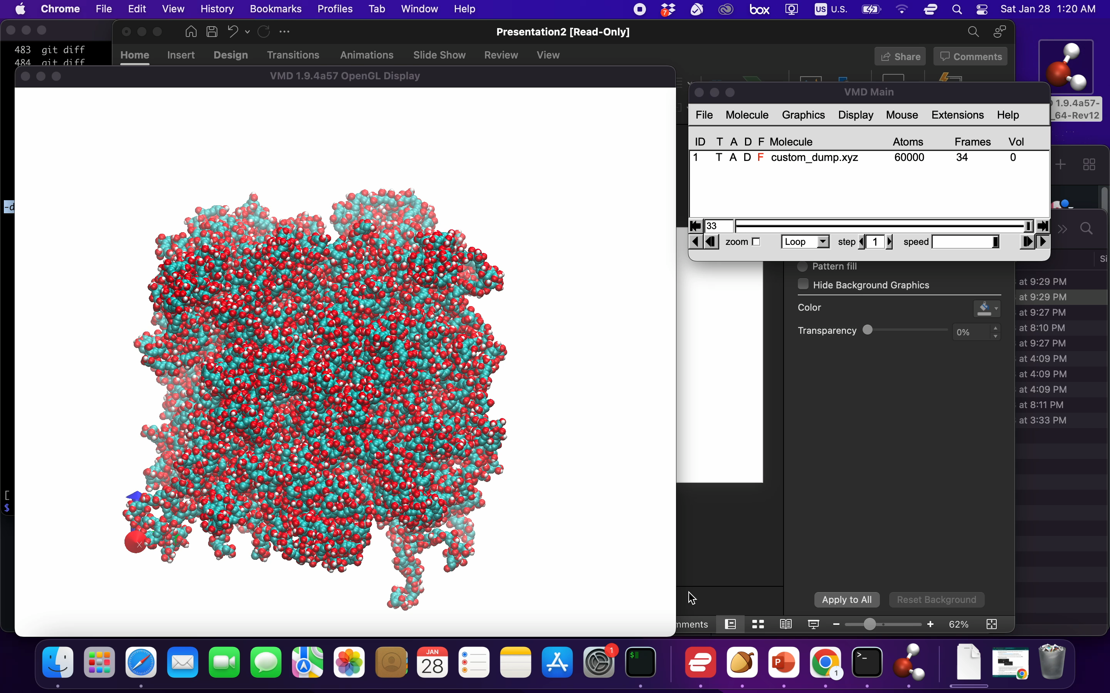
Efficient large scale amorphous cell builder with force field assignment supporting s polymers
run_nemd polymer_builder_driver.py '*CC(*)C(=O)O' '*CC(*)C(=O)O' -cru_num 100 -mol_num 100 -seed 1234 -density 0.5 -cell grow
velocity all create 10.0 482748
fix 1 all nvt temp 10.0 10.0 100
run 20000
unfix 1
fix 1 all npt temp 10.0 10.0 100 iso 1 1 1000
run 10000
30 mins on this mac:
60K atoms at density 0.5 g/cm^3
Cubic box of size 133.77 angstrom

Slide 2
Molecule blends via three different methods
polymer_builder_driver.py
Build amorphous cell from molecules and monomers.
positional arguments:
CRU SMILES of the constitutional repeat unit (monomer)
options:
-cru_num CRU_NUM [CRU_NUM ...]
Number of constitutional repeat unit per polymer
-mol_num MOL_NUM [MOL_NUM ...]
Number of molecules in the amorphous cell
-seed SEED Set random state using this seed.
-cell CELL Amorphous cell type: 'grid' grids the space and put molecules into sub-cells; 'pack'
randomly rotates and translates molecules; 'grow' grows molecules from the smallest rigid
fragments.
-density DENSITY The density used for pack and grow amorphous cell. (g/cm^3)

Slide 3
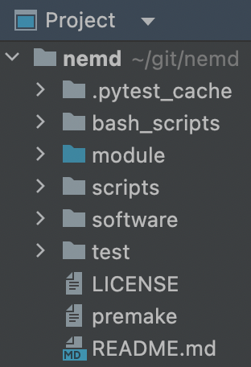
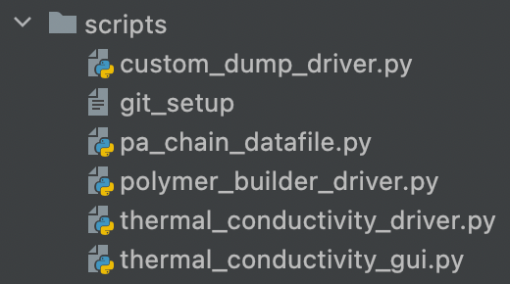
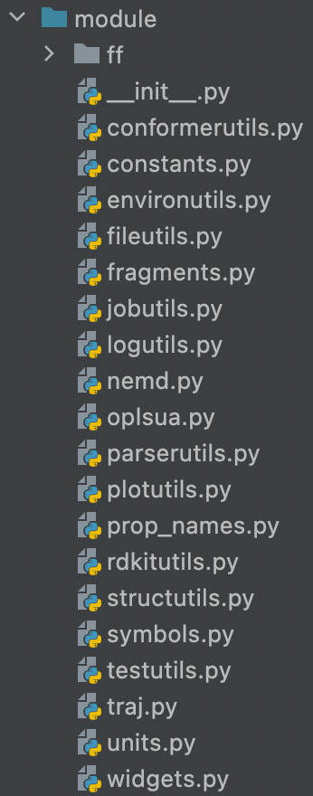
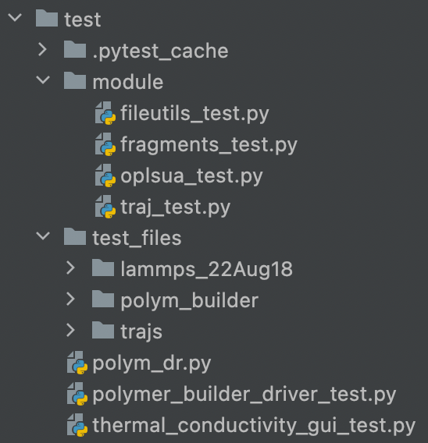
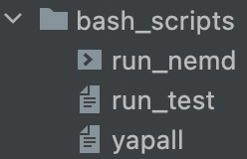
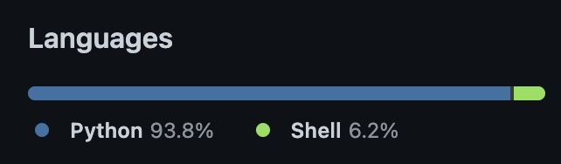
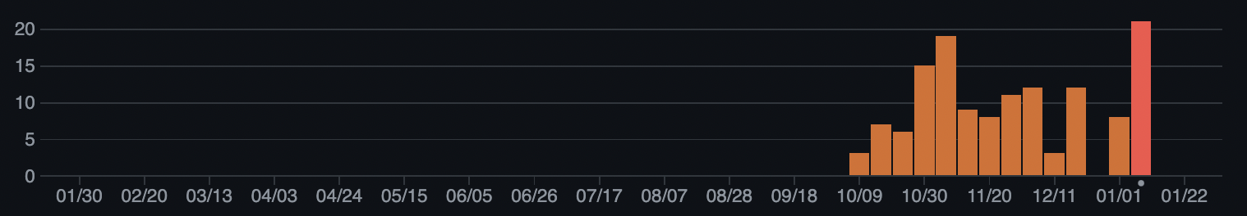
1000 lines for drivers
object oriented programming with doc strings
3000 lines for modules
modularization (handy api)
500 lines for unit tests
critical functionality protected

Slide 4
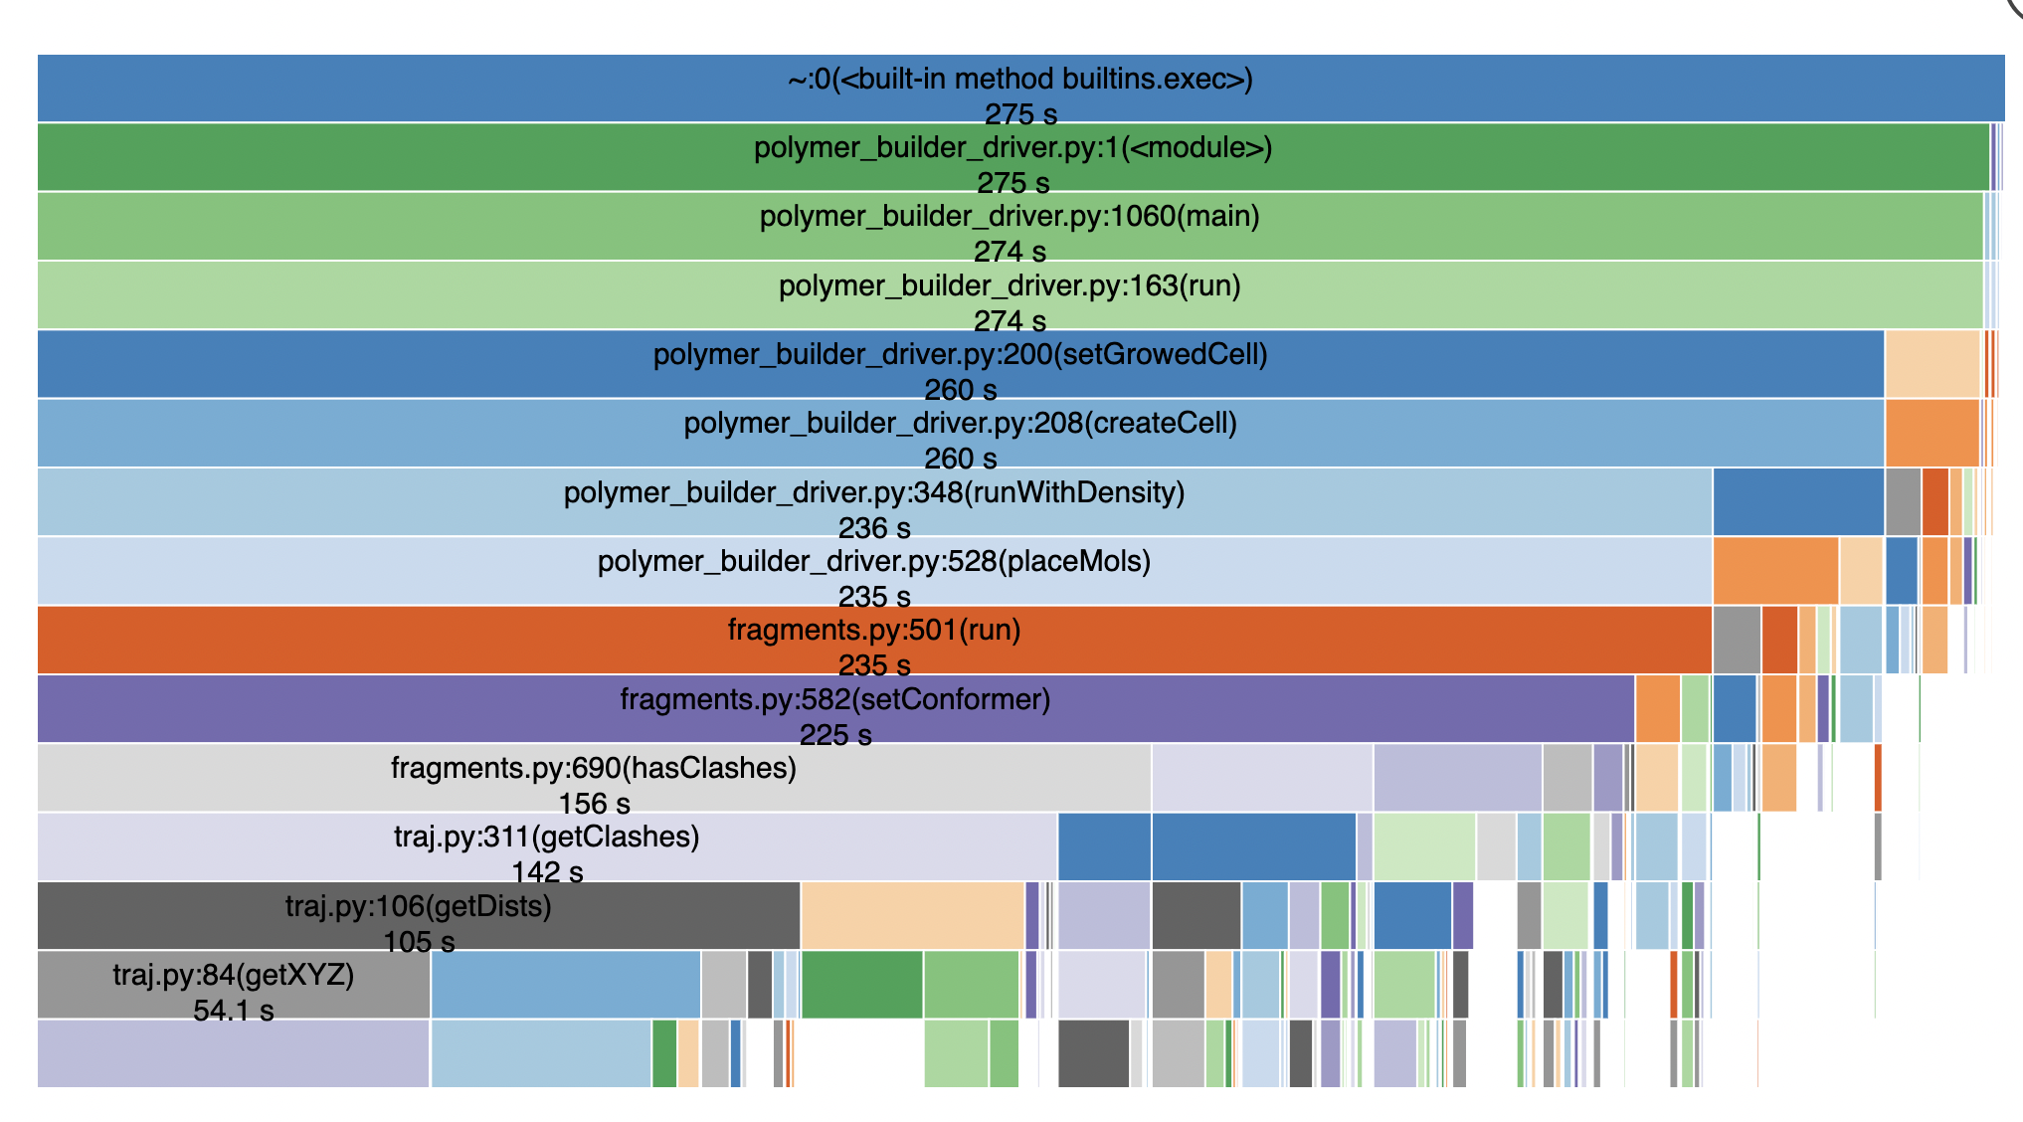

Slide 5
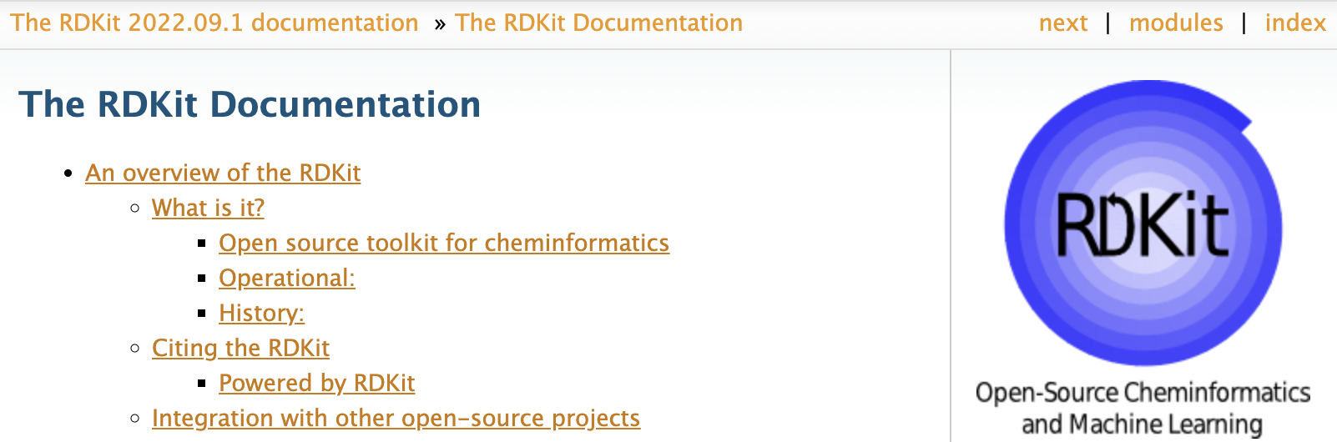
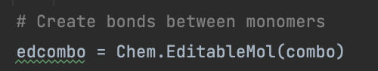

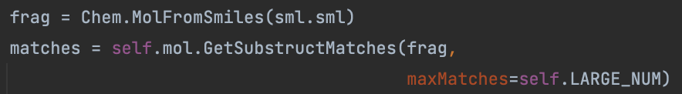
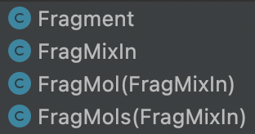
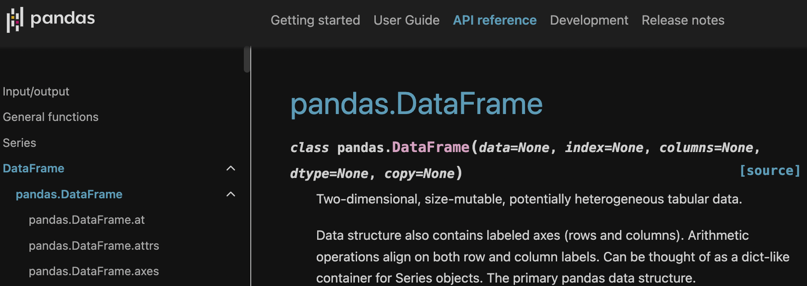
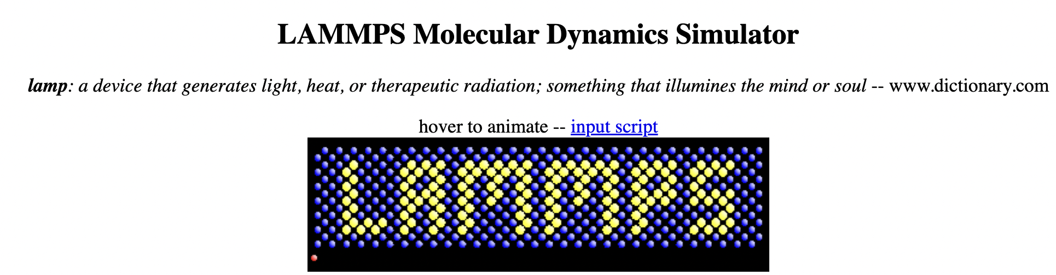
Components
SMILES to structure
Polymerization
Force field assignment
Coordinate generation
LAMMPS in script
LAMMPS datafile
Trajectory analysis
Refs:
RDKit: Open-source cheminformatics. https://www.rdkit.org
https://pandas.pydata.org/docs/index.html
Self-avoiding walk
(home-made)

Slide 6
run_nemd polymer_builder_driver.py '*CC(*)C(=O)O' -cru_num 10 -mol_num 10 -seed 1234 -density 0.5 -cell grow
lmp_serial < *.in or lmp_mpi *.in

